Slide 1

CS4225/CS5425 Big Data Systems for Data Science
Tutorial 1 Answers
Desmond Lau
School of Computing
National University of Singapore
dlau@nus.edu.sg

Slide 2
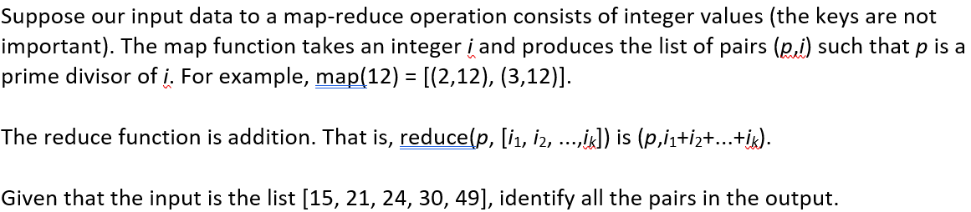
Question 1:

Slide 3
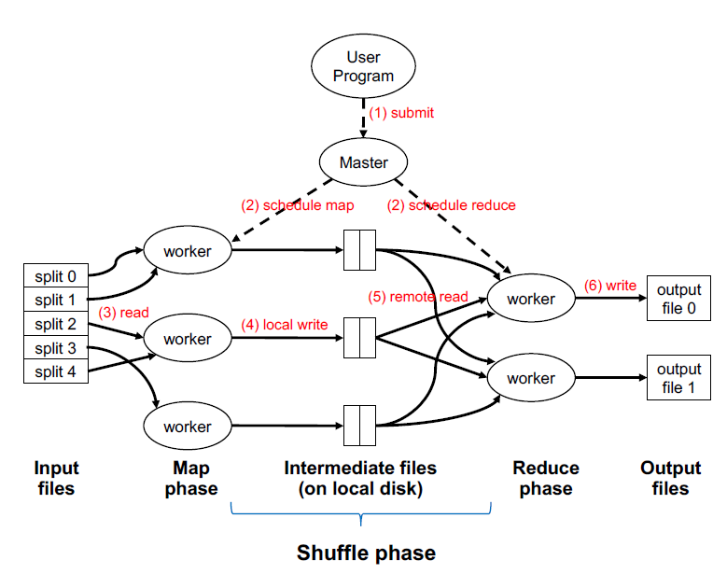
Solution 1:
Input Files:
[15, 21, 24, 30, 49]
Map Phase:
“The map function takes an integer i and produces the list of pairs (p,i) such that p is a prime divisor of I”
15 -> [(3,15), (5,15)]
21 -> [(3,21), (7,21)]
24 -> [(2,24), (3,24)]
30 -> [(2,30), (3,30), (5,30)]
49 -> [(7,49)]

Slide 4
Solution 1:
Output of Map Phase
End of Shuffle Phase (automatic) :
grouping by keys
15 -> [(3,15), (5,15)]
21 -> [(3,21), (7,21)]
24 -> [(2,24), (3,24)]
30 -> [(2,30), (3,30), (5,30)]
49 -> [(7,49)]
(2, [24, 30])
(3, [15, 21, 24, 30])
(5, [15, 30])
(7, [21, 49])

Slide 5
Solution 1:
Input of Reduce Phase
Output of Reduce Phase:
“The reduce function is addition. That is, reduce (p, [i₁, i₂, …, i_{k}] is (p, i₁ + i₂+ … + i_{k})”
(2, [24, 30])
(3, [15, 21, 24, 30])
(5, [15, 30])
(7, [21, 49])
(2,54)
(3,90)
(5,45)
(7,70)

Slide 6
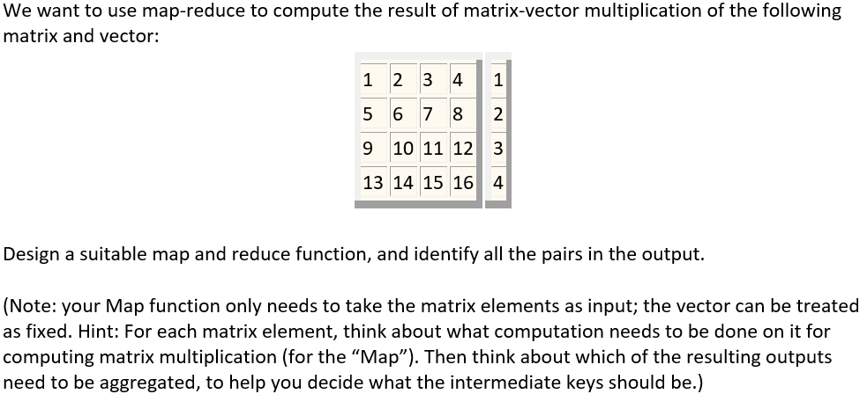
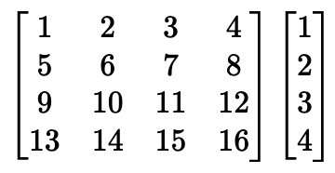
Question 2:

Slide 7
Solution 2:
Imagine the matrix given is truncated, such that…
Part of a large matrix
(n x 4)
Small vector
(4 x 1)
Too large to be stored on single machine. To be distributed to cluster of machines. Map function takes matrix elements as input
Fixed vector stored on every machine in cluster
n >> 4
input to the mapper function is (value, row, col). e.g:
(1, 1, 1), (2, 1, 2), … , (16, 4, 4)

Slide 8
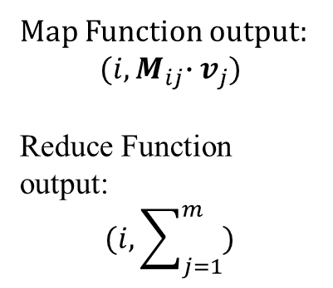
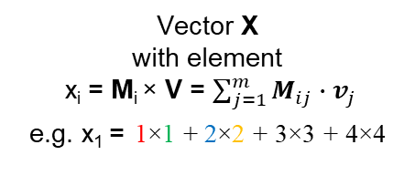
Solution 2:
Map Input :
(1, 1, 1),
(2, 1, 2),
… ,
(16, 4, 4)
(M_{ij}, i, j)
(n x m)
(m x 1)
(n x 1)
Map Function output:
$${(i,M}_{ij}∙v_{j})$$
Reduce Function output:
$$(i, \sum_{j=1}^{m}{)}$$
1×1 + 2×2 + 3×3 + 4×4
5×1 + 6×2 + 7×3 + 8×4
9×1 + 10×2 + 11×3 + 12×4
13×1 + 14×2 + 15×3 + 16×4
×
=
Matrix M
with Matrix Element, M_{ij}
Vector V
with element
v_{j}
Vector X
with element
x_{i} = M_{i} × V = $\sum_{j=1}^{m}{M_{ij}∙v_{j}}$
e.g. x₁ = 1×1 + 2×2 + 3×3 + 4×4

Slide 9
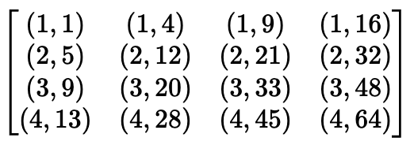
Solution 2:
1×1 + 2×2 + 3×3 + 4×4
5×1 + 6×2 + 7×3 + 8×4
9×1 + 10×2 + 11×3 + 12×4
13×1 + 14×2 + 15×3 + 16×4
×
=
Map: Thus, the sixteen key-value pairs produced are:
Reduce: sum the values corresponding to the same key, thus, results of reduce are: (1,30), (2,70), (3,110), (4,150)

Slide 10
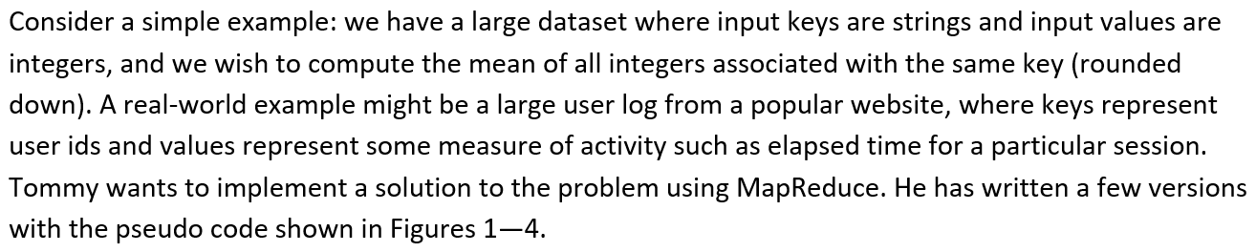
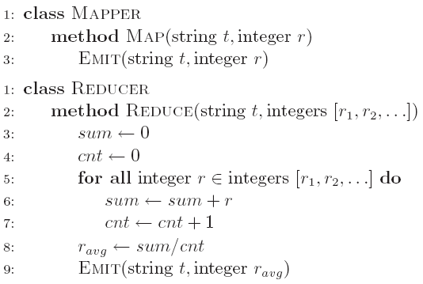
Question 3a:
a) Initially, Tommy has finished an implementation with Version 1 (Figure 1). He finds that the implementation can have correct results, but the performance is very slow. Why?
Notes:
We can assume this is the result of word count on every single document
Which is the occurrence of word on the whole dataset..

Slide 11
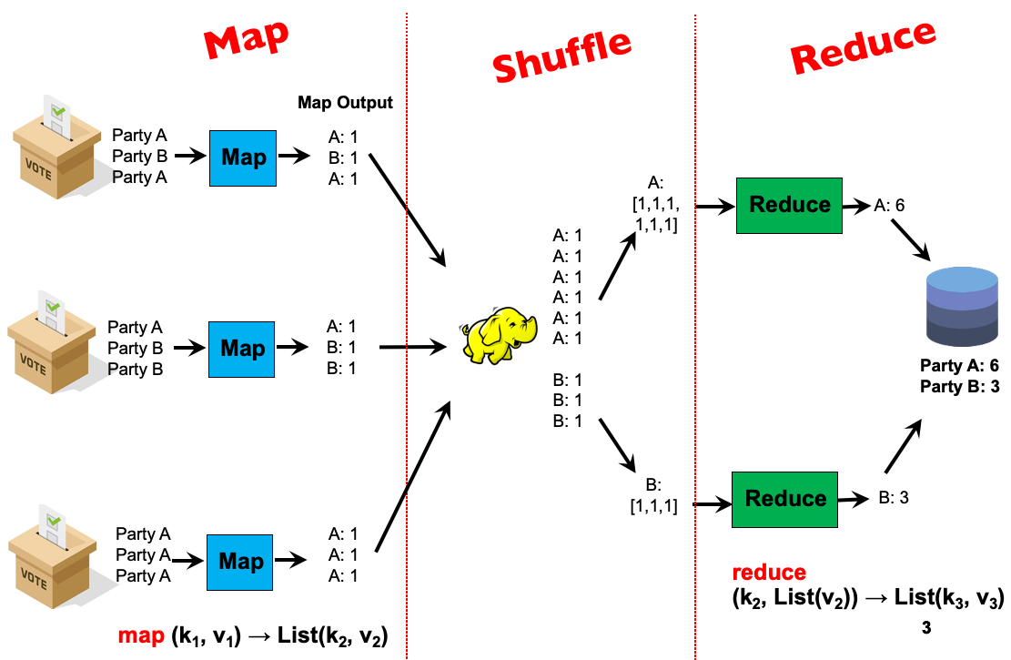
Solution 3a:
It requires shuffling all key-value pairs from mappers to reducers across the network, which is highly inefficient.
key
value

Slide 12
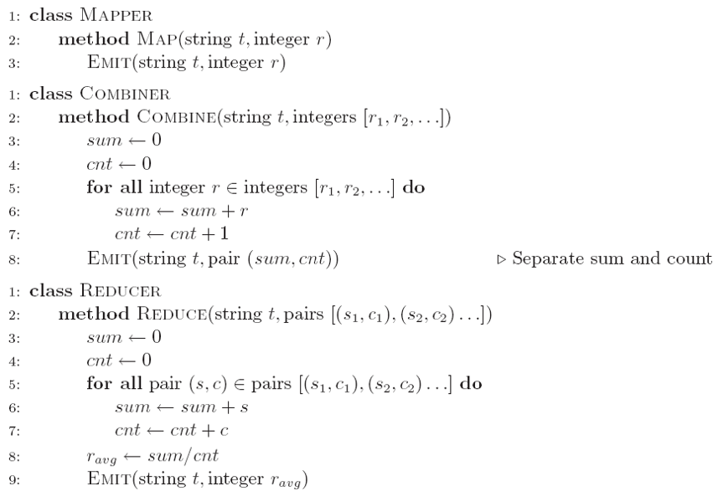
Question 3b:
b) Tommy wants to improve the performance using combiners. He comes up with the second implementation (Version 2 in Figure 2). He finds that he can seldom get reasonable results. Why?
Notes:
We can assume this is the result of word count on every single document
Which is the occurrence of word on the whole dataset..

Slide 13
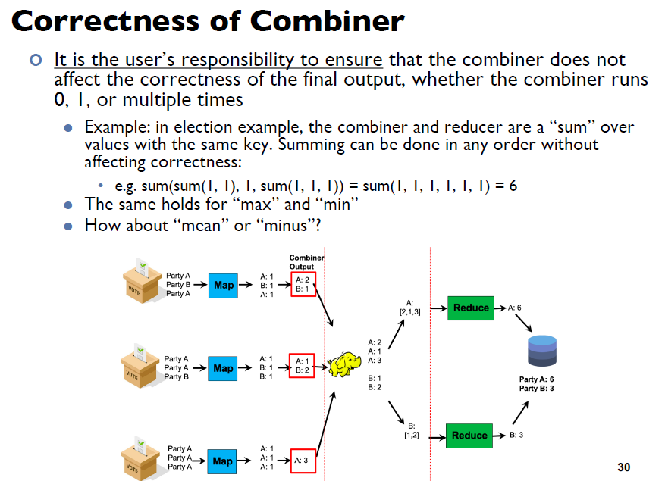
Solution 3b: Recap – Lecture 2 Slide 53
Combiner reduces number of data transmission, BUT
algorithm in Combiner must be designed such that MapReduce still work even if Combiner did not execute.

Slide 14
Solution 3b:
Case 1: Combiner always run
MapReduce works as combiner output has same key-value type as reducer input
Case 2: Combiner not run sometimes
MapReduce does not work as mapper output has different key-value type as reducer input
Conclusion: combiners must have the same input and output key-value type, which also must be the same as the mapper output type and the reducer input type (ignoring the fact that the combiner and reducer’s input is a list of values).
Notes:
We can assume this is the result of word count on every single document
Which is the occurrence of word on the whole dataset..

Slide 15
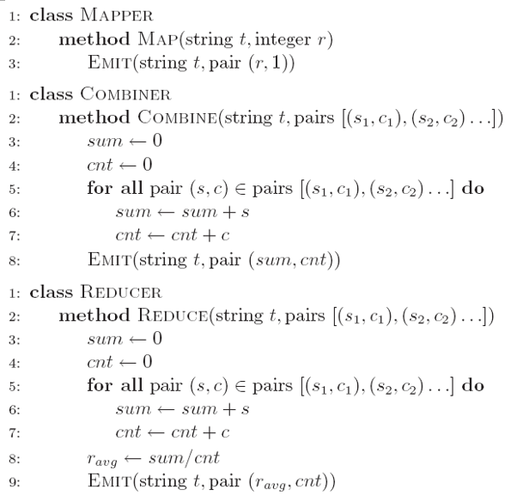
Question 3c:
c) After careful design, Tommy finally develops an efficient and correct implementation (Version 3 in Figure 3). Analyze the correctness of the combiner and the efficiency of the algorithm (i.e., why it is more efficient than Version 1).
Notes:
We can assume this is the result of word count on every single document
Which is the occurrence of word on the whole dataset..

Slide 16
Solution 3c:
Mapper:
Key: string t
Value: a pair consisting of integer and 1
This corresponds to a partial count over 1 instance
Combiner:
Combiner aggregates the partial sums and the partial counts and emits pairs with updated sums and counts.
The number of key-value pairs is reduced, thus shuffle and sort can be more efficient.
Reducer:
Similar algorithm as combiner, with mean computed at the end.
In essence, the algorithm transforms a non-associative operation (mean of numbers) into an associative operation (element-wise sum of a pair of numbers, with an additional division at the very end).
Associative Operation: (a+b)+c=a+(b+c)

Slide 17
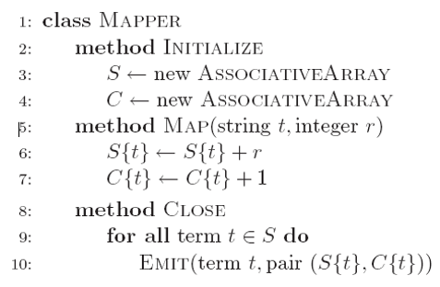
Question 3d:
d) Tommy analyzes the efficiency of Version 3 and comes up with an alternative implementation without a combiner (Version 4 in Figure 4). Is it as efficient as Version 3? Why or why not?
Notes:
We can assume this is the result of word count on every single document
Which is the occurrence of word on the whole dataset..

Slide 18
Solution 3d:
Inside the mapper, the partial sums and counts associated with each string are held in memory, across input key-value pairs.
Like before, the mapper output value is a pair consisting of the sum and count.
The input value for each key is aggregated over the entire input by the mapper.
The number of key-value pairs emitted by the mapper, and thus the I/O cost between the mapper and reducer, goes down (compared to version 1)
Here we are using the in-mapper combiner pattern rather than a regular combiner as in version 3, but they are equally efficient.
Version 3
Version 4

